Slide 1
INDUSTRIAL MANAGEMENT
MODULE 2

Slide 2
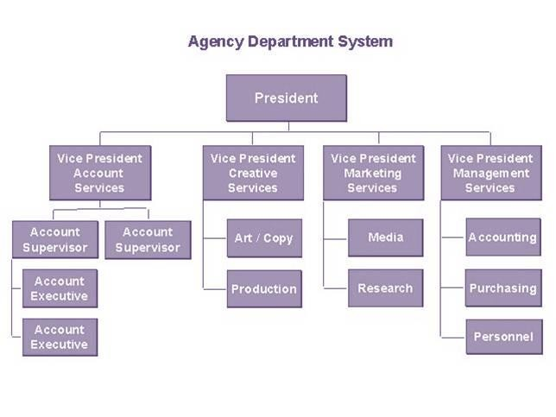
ORGANIZATIONAL CHARTS IN ORGANIZING
A major reason for conflict in organizations is that people do not understand their assignments and those of their coworkers
Understand is aid by Organization charts
An organization chart, indicates how departments are tied together along the principal lines of authority

Slide 3



ORGANIZATIONAL CULTURE
GENERAL ELECTRIC
“Progress is our most important product”
“Better things for better living through chemistry”

Slide 4
Organizational culture
The general pattern of behavior, shared beliefs and values that
organization members have in common
Culture can be inferred from what people say, do and think within the
organizational setting
It involves the learning and transmitting of knowledge, beliefs and patterns of behavior over a period of time, which means that an organization culture is fairly stable and does not change fast.

Slide 5

STAFFING AND RELATED HRD FUNCTIONS
Story of
apple

Slide 6
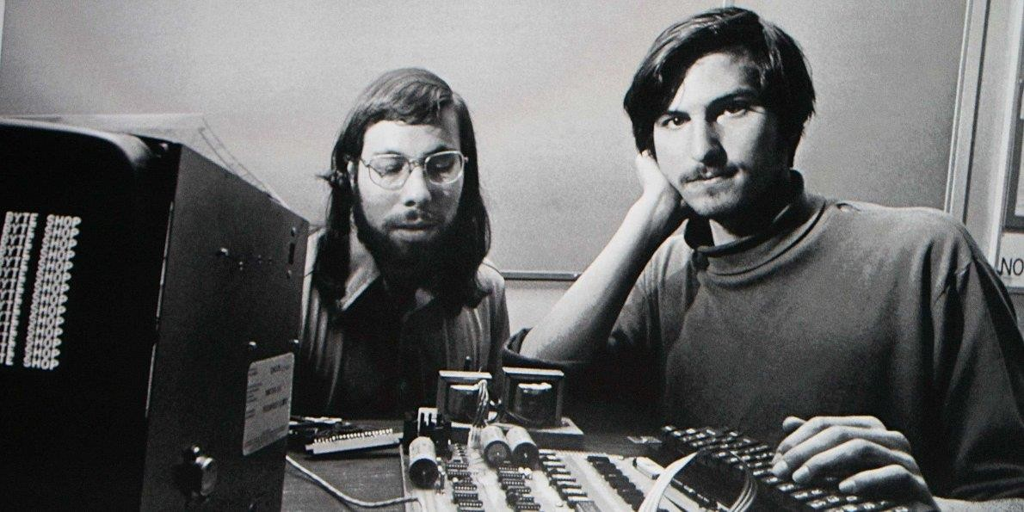
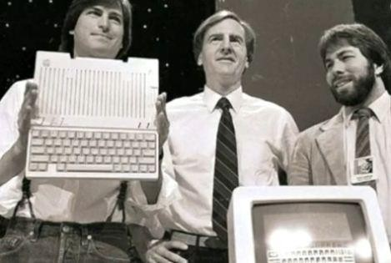
Steve jobs & Steve Wozniak invented the personal computer in 1976
In 1978 first personal computer
was launched
At that time IBM was dominant company in bid-computer market
1981 IBM realized the importance of personal computer, jobs countered with macintosh

Slide 7
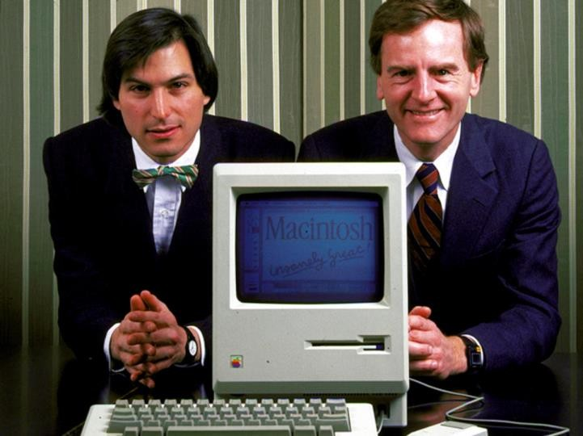
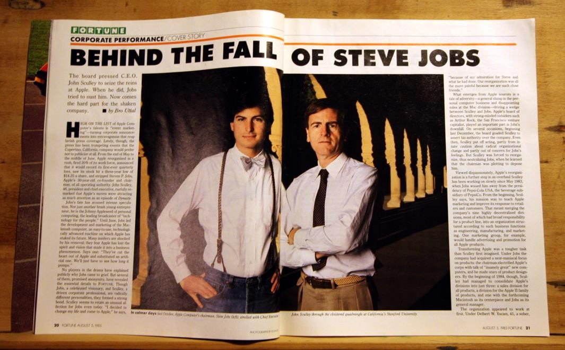
Jobs hired John Sculley who conducted advertising campaign at Pepsico.
Soon company visions by Sculley and jobs departed
Sculley fired Jobs in 1985
1993 Sculley was replaced by Michel Spindler due to non profitability

Slide 8
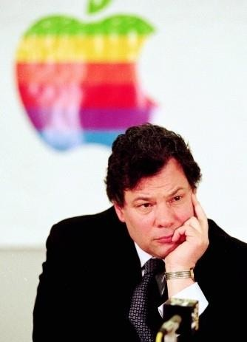
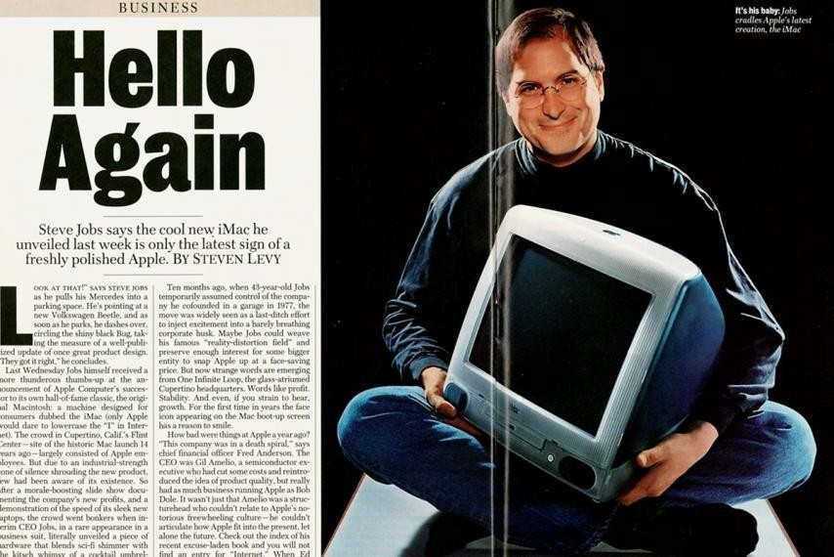
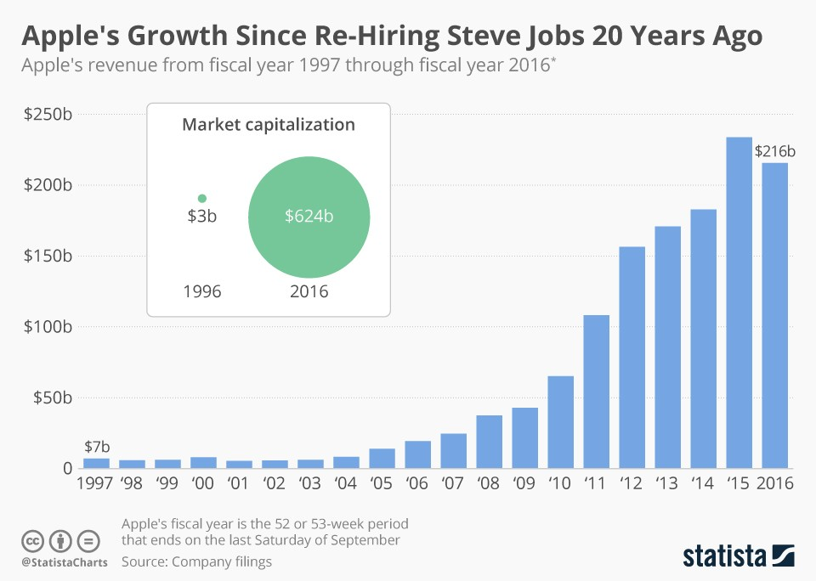
Spindler focused on cost-cutting rather than innovative differentiation
Losses continued
1996 Spindler was replaced by Gilbert Amelio
Apple continued being in financial trouble
1996 apple rehired Jobs to Apple

Slide 9
Story of apple point outs
“The selection of top leadership is perhaps the most important HR selection; however, HR choices have major impact - positive or negative - at all levels of the firm and can be a source of innovation or stagnation.”

Slide 10
HUMAN RESOURCE MANAGEMENT (HRM)
HRM or Staffing is defined as the management function devoted to acquiring, training, appraising and compensating employees
Staffing is done by identifying workforce requirements, inventorying the people
Staffing
available and, promoting, appraising, recruiting, selecting, placing careers of candidates or current job holders
Filling and positions in structure
keeping filled
the organization

Slide 11
PROCESS OF STAFFING FUNCTION
Man power planning
Recruitment
Selection
Orientation and placement
Promotion and transfer
Performance evaluation
Remuneration
Training and development

Slide 12
FACTORS AFFECTING STAFFING
Promotion policy
Future growth plans
Technology used
Support from top management
Reputation of organization
Labour laws
Pressure from socio political groups
Competition
Other external factors

Slide 13
MANAGER INVENTORY CHART
At a glance, the controller can see where he/she stands with respect to the staffing function.

Slide 14
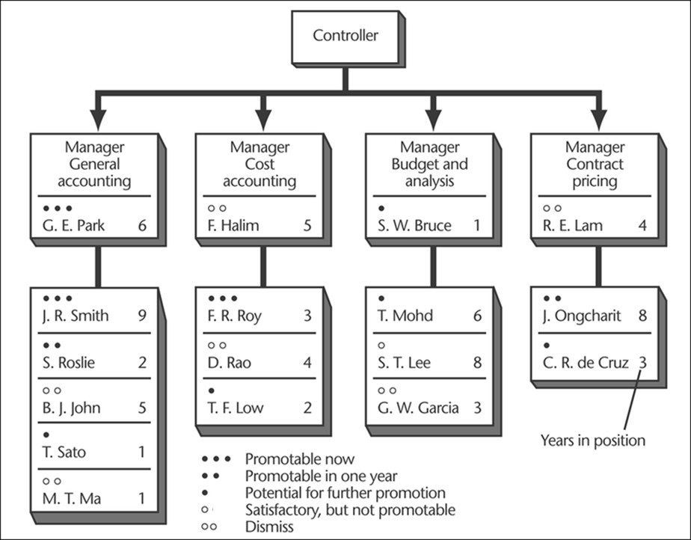

Slide 15
PERSONNEL ACTIONS BASED ON MANAGER SUPPLY AND DEMAND WITHIN THE
ENTERPRISE
SUPPLY OF MANAGERS
High
Low
Selection Placement promotion
Internal:
Training and development Compensation
External :
Recruitment
DEMAND FOR MANAGERS
High
Change in company plans
Outplacement Layoffs Demotions Early retirement
Training and development if change in demand is expected in the future
Low

Slide 16

MATCHING PERSON WITH THE JOB
Selection
Choosing candidates,
from among from within or
the
outside the organization,
most suitable person for a position

Slide 17
Plant equipment, materials and people do not make a business any more than airplanes, tanks, ships and people make an effective military force
The quality of manager is one of the most important factors determining the continuing success of any organization.

Slide 18
SYSTEMS APPROACH TO SELECTION
A systematic approach is essential to manager selection and to the assessment of present and
future needs for managerial personnel
This plan is translated into position requirements and job design, which are matched with such individual characteristics as
The managerial requirements plan
is based on
The firm’s objectives
Forecasts
Plans
Strategies
Intelligence
Knowledge
Skills
Attitudes
experience
1
2

Slide 19
To meet
the organizational
After selection and placement, managers are introduced to new job.
The orientation involves learning about the company, its operation and its social aspects
4
requirements managers
Recruit,
Select,
Place
Promote People
3
Done by considering internal environment (company policies, manager supply and demand, organizational climate) and external environment (laws, regulations, availability of managers)
The newly placed managers then carry out their managerial
and nonmanagerial functions and resulting managerial
performance will eventually enterprise performance
Managers who meet their performance goals are rewarded.
Appraisal may also become the basis for promotion, demotion,
replacement and retirement decisions
5
39

Slide 20
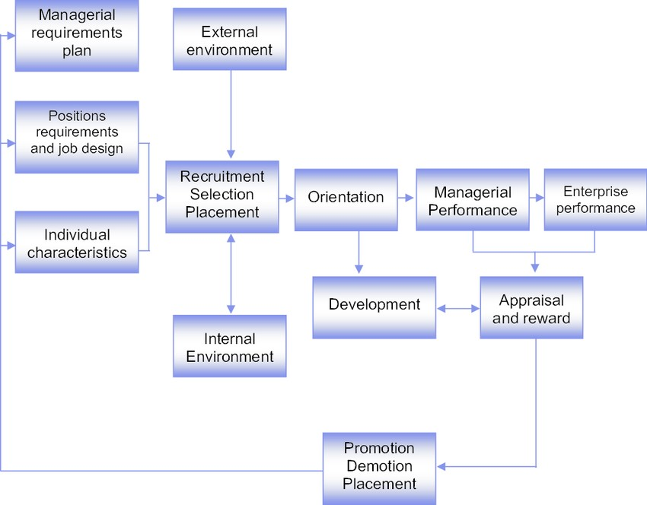

Slide 21
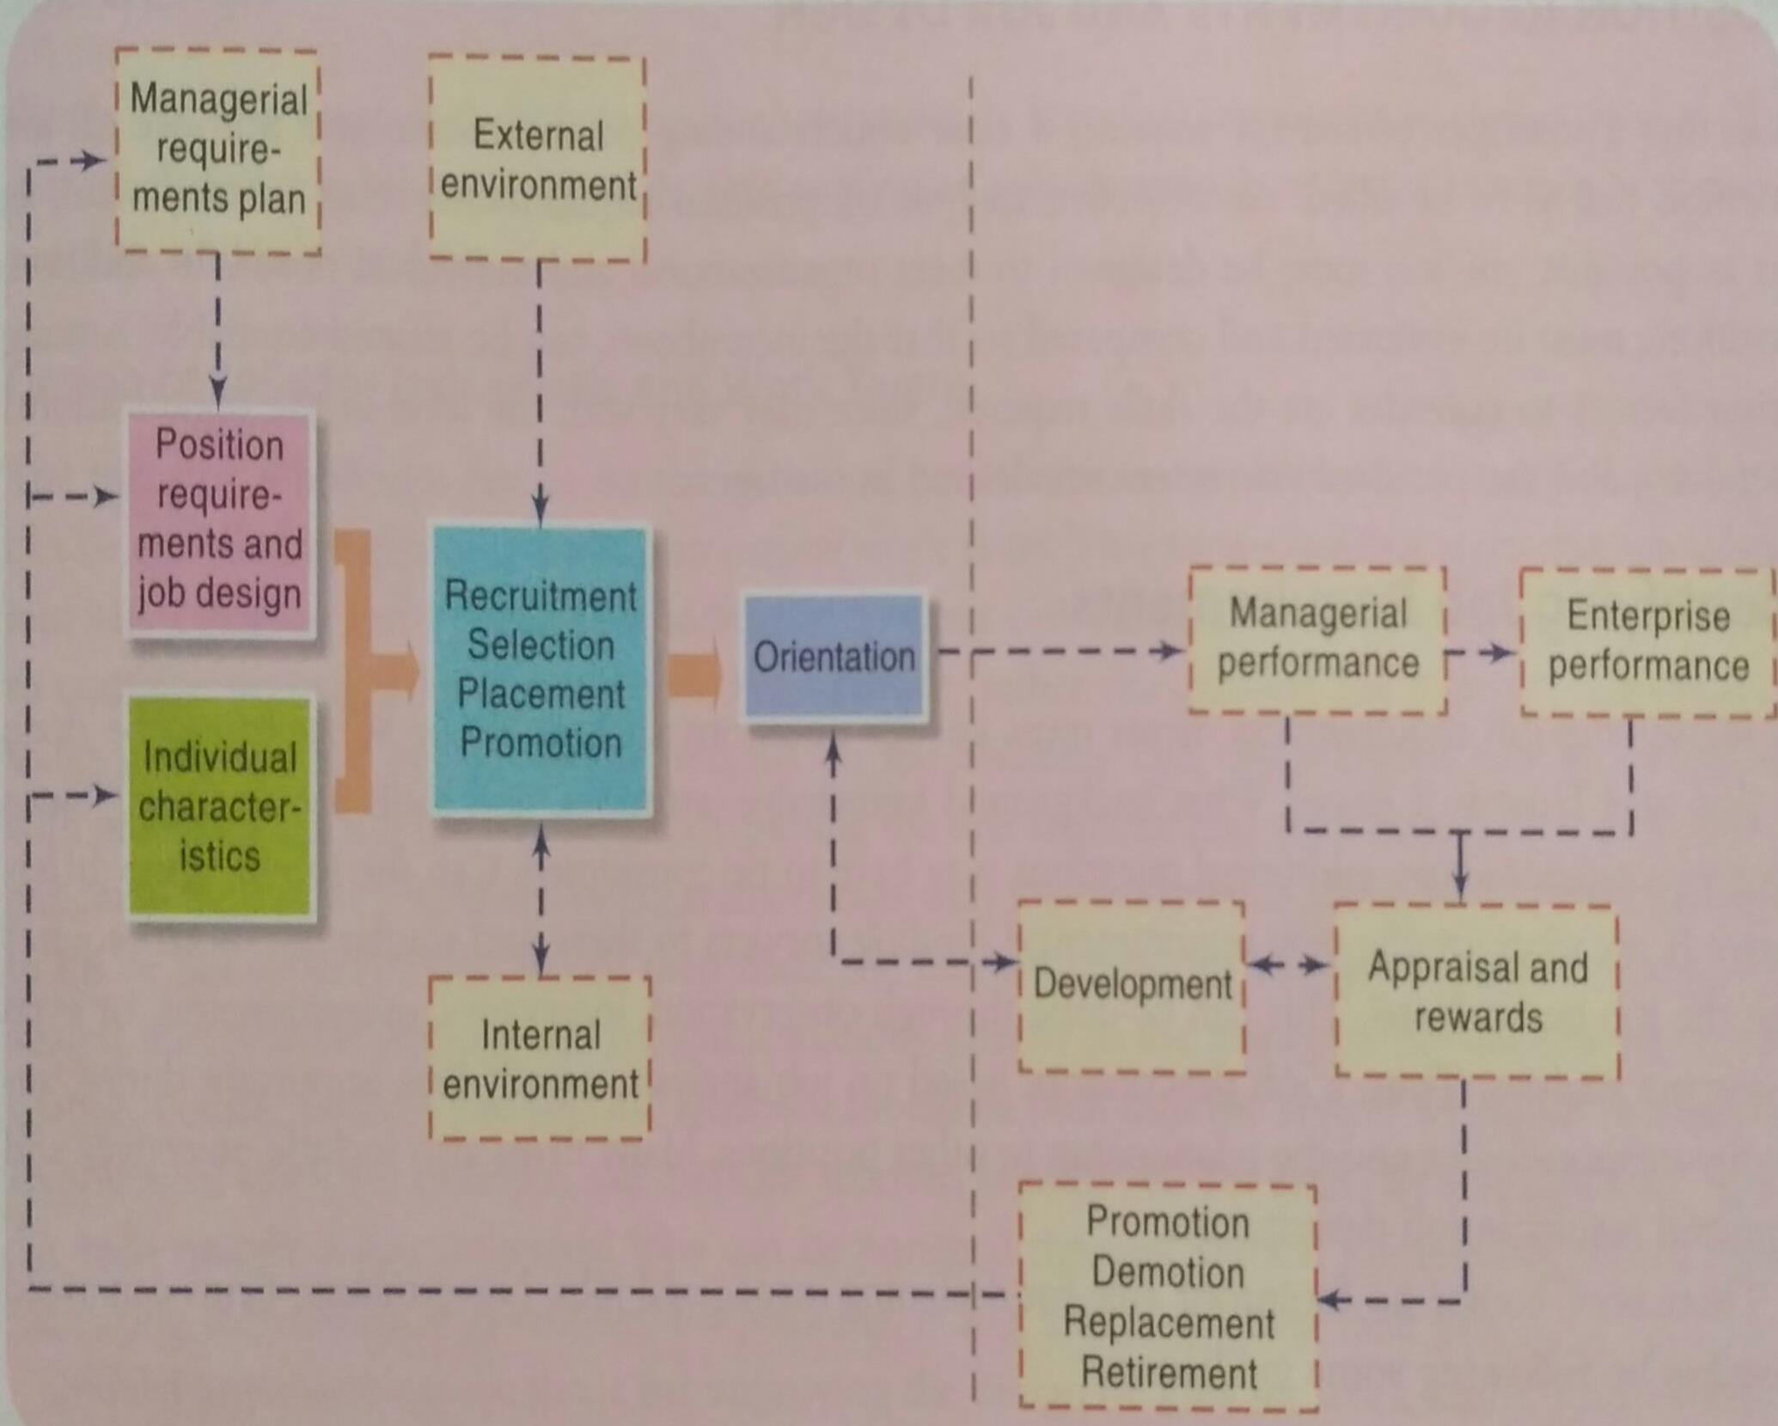

Slide 22

JOB DESIGN AND ANALYSIS
Selecting manager effectively requires a clear understanding of the nature and purpose of the position that is to be filled.

Slide 23

A job analysis of position requirements must be made and job must be designed to meet organizational and individual needs

Slide 24
JOB ANALYSIS
Job analysis is the process of gathering relevant information about various aspects of a job including its content, context and job performer's skill requirements
Job analysis answers the questions
What to do?
Why?
How to do it?
Helps mainly to identify problems and solutions

Slide 25
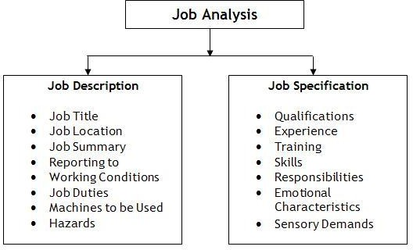
Results of job analysis are normally presented in the form of job description and job specification

Slide 26
Job specification
Job description
It is narration of the contents of
a job
It is the description of activities and duties to be performed in a job, relation of job with other jobs, hazards of the jobs etc.
It is a statement of the minimum
level of qualifications, skills,
physical and experience required for effectively
other abilities, and attributes performing job

Slide 27
POSITION (JOB) REQUIREMENTS
Selecting a manager effectively requires a clear understanding of the nature and purpose of the
position that is to be filled.
The job must be designed to meet organizational and individual needs

Slide 28
IDENTIFYING JOB REQUIREMENTS
Firm must answer the questions
What has to be done in this job?
How it is done?
What background knowledge, attitudes and skills are required?
Can the job be done differently?
What are the new requirements?
Finding answer to these questions requires job analysis

Slide 29
Job analysis can be done through
Observation
Interviews
Questionnaires
Systems analysis
Job analysis describes
Important duties
Authority
Responsibility
Relationship to other positions

Slide 30
JOB DESIGN
Job design is process of organizing tasks, duties and responsibilities into a
unit of work to achieve organizational objectives
Job design defines the various tasks required to do a specific job and the method of performing of tasks.
Job design establishes the relationships that should exist between the job holder and his superiors

Slide 31
STEPS INVOLVED IN JOB DESIGN
Specifying individual
tasks
This means that the different tasks to be included in a job are specified and are categorized
Specifying methods
Specification of methods provides the basic guidelines to perform the job
Combining tasks into jobs
Individual tasks are combined into a group and assigned to individual employee or group

Slide 32
FACTORS AFFECTING JOB DESIGN
Organization’s requirements
Individual differences -
Technology involved
Cost associated with restructuring the jobs
The organization structure
The internal climate

Slide 33
SKILLS AND PERSONAL CHARACTERISTICS NEEDED IN MANAGERS
Technical
Human
Conceptual
Design
Analytical and problem solving abilities
Personal characteristics

Slide 34
Technical skill
Ability to use equipment, methods and techniques involved in performing specific tasks
Conceptual skill
It is the ability to recognize the different functions of business and ability to guide the organizational efforts to achieve the goal of the enterprise
Human relational skill
The ability of a manager to work with, understand and motivate people in the organization
Human relation skill include
Motivating skills
Leadership skill

Slide 35
Analytical skills
Personal characteristics
Desire to manage
Communication skills and empathy
Integrity and honesty
Managers must be able to identify problems, analyze complex situations and by
solving the problems
encountered, exploit
opportunities presented
Analytical skills should be
used to find the needs of the present customers

Slide 36
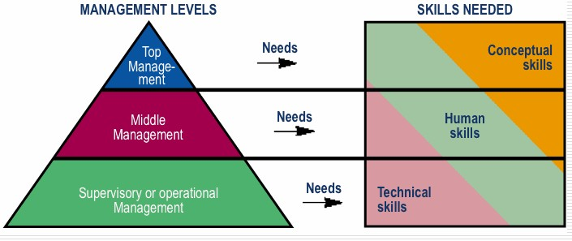

Slide 37
RECRUITMENT OF MANAGERS
Recruiting
Recruitment is process of searching for prospective employees and stimulating them to apply for jobs in the concern
Attracting positions structure
candidates to fill in the organization

Slide 38
Main sources of labour
From within the company
By 1. promotion
2. Transfer
✔ Internal recruitment may lead to increase in employee’s productivity , saves time, money, efforts
× It does not allow the organization to have fresh brains.
From outside the company
By 1. Employment exchange
Advertisements
Colleges
Foreign agencies
5. Manpower consultancies
58

Slide 39
RECRUITMENT PROCESS
Identifying the
vacancy
Locating and developing the sources of required number and type of employees
Preparing the job description and person specification
Screening

Slide 40
SELECTION PROCESS, TECHNIQUES AND INSTRUMENTS
Validity
The degree to which the data
predict the candidate’s success as
a manager
For good selection process, the information about the applicant should be valid and reliable
Reliability
The accuracy and consistency of
the measurement

Slide 41
SELECTION PROCESS
It is a process of examining the applicants to find out the suitability of the applicant for the job and choosing the best from them

Slide 42
PROCESS
Selection criteria are established (Education, knowledge, skills and experience)
Candidate fill the application form
Screening interviews are done to identify more promising candidates
Test candidate’s qualification
Formal interviews are then conducted by the manager
Information provided by the candidate is checked and verified
Physical examination
Provide Job offer

Slide 43
TECHNIQUES FOR SELECTION
Interviews
Tests

Slide 44
INTERVIEW
An interview is a conversation between an applicant and the interviewer (recruiting officer) in which the interviewer asks questions to the applicant on various topics and judge their ability and sustainability.
Interview helps to find out the communication abilities of the applicant
It gives the applicant to learn the opportunities and job possibilities that exist in the
organization

Slide 45




Types of interviews
Traditional face-to-face interview
Panel/Committee interview
Telephonic interview
Stress interview

Slide 46
TESTS
o The primary aim of testing is to obtain data about applicants that help to predict their probable
success as managers
TYPES OF TESTS
Intelligence tests – designed to measure mental capacity and to test memory, speed of thought and ability to see relationships in complex problem situations
Proficiency and aptitude tests – discover interests, existing skills and potential for acquiring skills
Vocational tests – designed to indicate candidates most suitable occupation or the areas in
which the candidates' interests match the interest of people working in those areas
Personality tests – designed to reveal a candidate’s personal characteristics and the way candidate may interact with others

